Slide 1

Class 6
Joins & Exam Prep
By Arsames Qajar qajar@usc.edu

Slide 2
Outline
Questions class 5 & please download in class problems for today on BB
Intro to Joins
Inner and Outer Joins
Joins on Derived tables
Sample Exam

Slide 3
JOINS - Merging Tables Merging/joining multiple tables

Slide 4
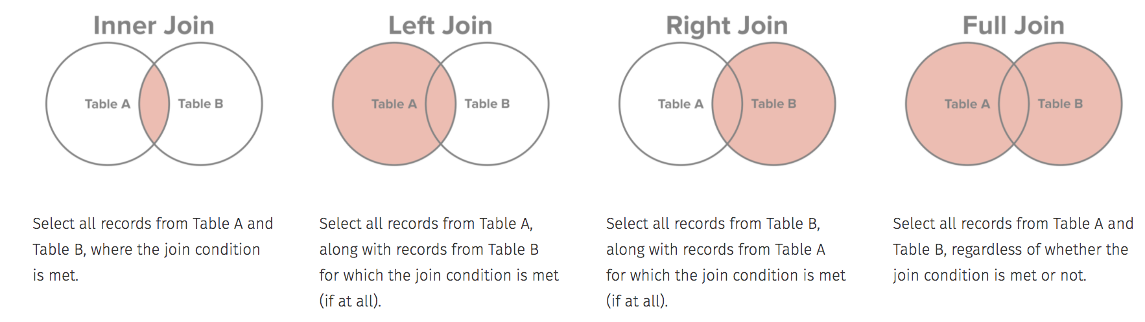
JOINS - Merging Tables
SELECT
*
FROM <first_table>
<join_type> <second_table> <alias>
<join_condition>;
Brings data together from multiple tables
Joins are and are only executed at query time
Can be written in the WHERE clause as well, but more standard to use the Join keyword
See Join types below:
Notes:
Select …
From table1 as t1
[inner/right/left] JOIN table2 as t2 on t2.column = t1.column

Slide 5
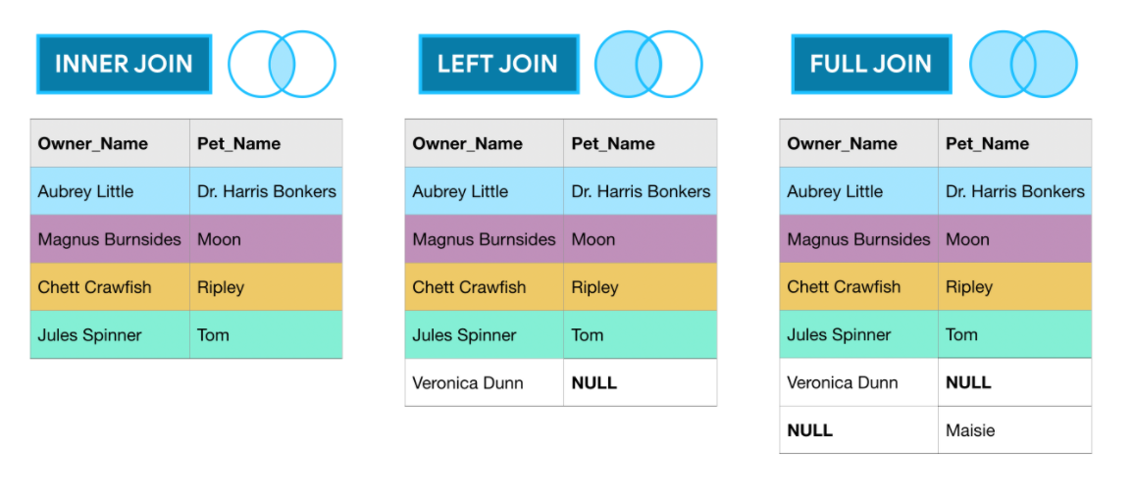
Joins

Slide 6
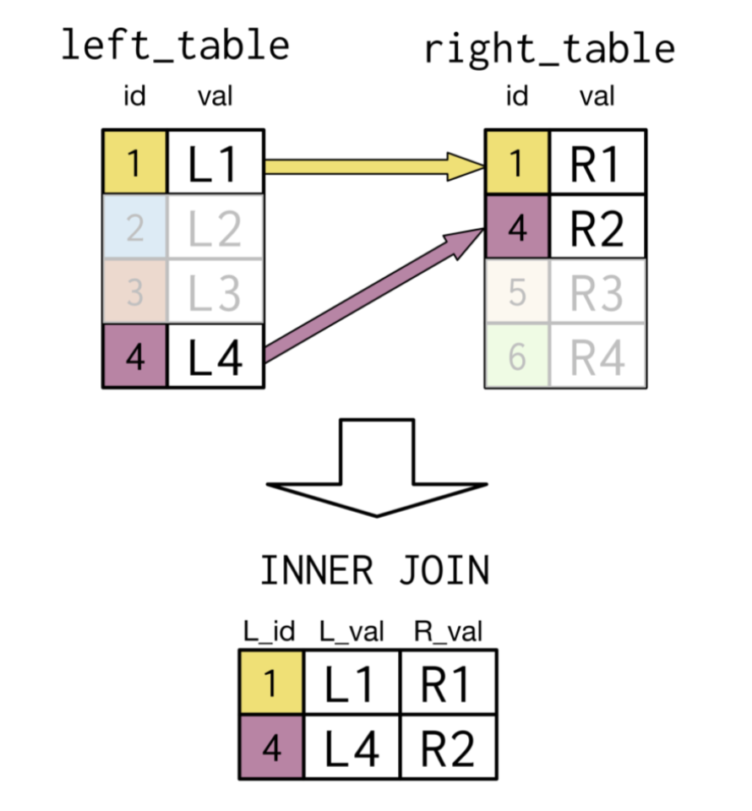
Inner Joins
Values (1,4) in a specified column (id) must match

Slide 7
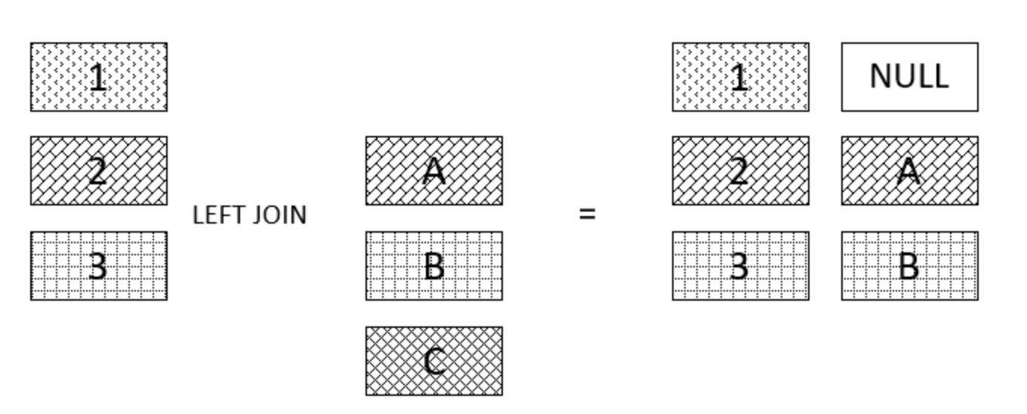
Outer Joins

Slide 8
Inner Joins
Example
Question:
Return the top 10 by product_name field ascending along with the category_name (Categories table) and limit to 5 results.
What data/attributes do we need in the final result ? Are these attributes all from one table or multiple?
Is there any attribute or value we can use to relate these tables?

Slide 9
Inner Joins
Example
Question:
Return the top 10 by rows in the Products table by the product_name field ascending along with the category_name (Categories table) field of each product and limit to 5 results.
SELECT
[ which fields do I need? Are they from different tables ? Is the data all in one table but needs two separate views of the data e.g. employee & manager ]
FROM
[ list the tables needed to join and the Primary Key (PK) - Foreign Key (FK) you will join on ]
LIMIT 5

Slide 10
Case Statement
Group By example
SELECT <column_list>,
CASE
WHEN condition1 THEN result1
WHEN condition2 THEN result2
WHEN conditionX THEN resultX
ELSE result
END <alias>;
FROM <table>
Case statements
CASE expression evaluates each row against each WHEN condition, one by one, from the top to bottom until it finds a condition that evaluates to true
If no matches are found or conditions found to be true, then the CASE expression return the ELSE result
Can provide an alias to the case statement to refer to it for later use in other clauses

Slide 11
Resources &
References

Slide 12
Subquery Types
1. Table subquery—an embedded SELECT expression that returns one or more columns and zero to many rows
2. Scalar subquery—an embedded SELECT expression that returns only one column and no more than one row
3. Correlated vs Uncorrelated -- The subquery is uncorrelated/correlated if a value that it returns depends upon any column of the outer query

Slide 13
Subquery Types cont’d
Uncorrelated - subqueries are completely self-contained & does not depend. The subquery only needs to be called once during the entire execution of the outer query. Inner query executes first.
select col1, col2
from table1 where col1 = (select max(col1) from table2);
Correlated - depends on columns outside subquery. It is called once for each row in the outer query and is passed a value (table1.c2). Outer query executes first
select c1, c2
from table1 where c1 = (select col1 from table2 where col2 = table1.c2);

Slide 14
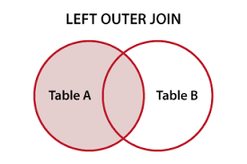
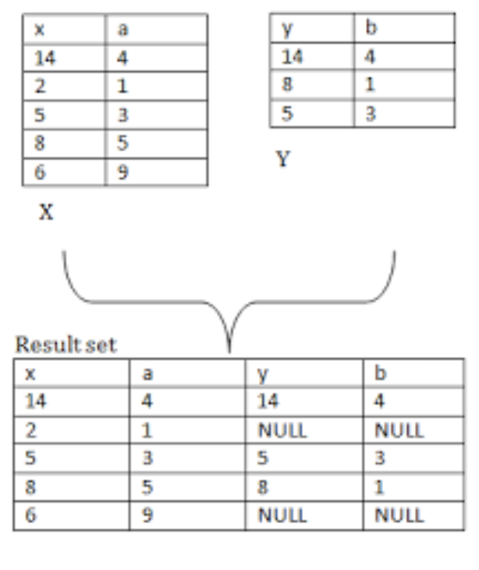
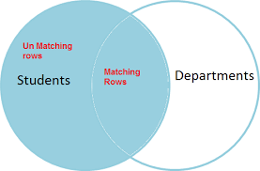
Outer Joins

Slide 15
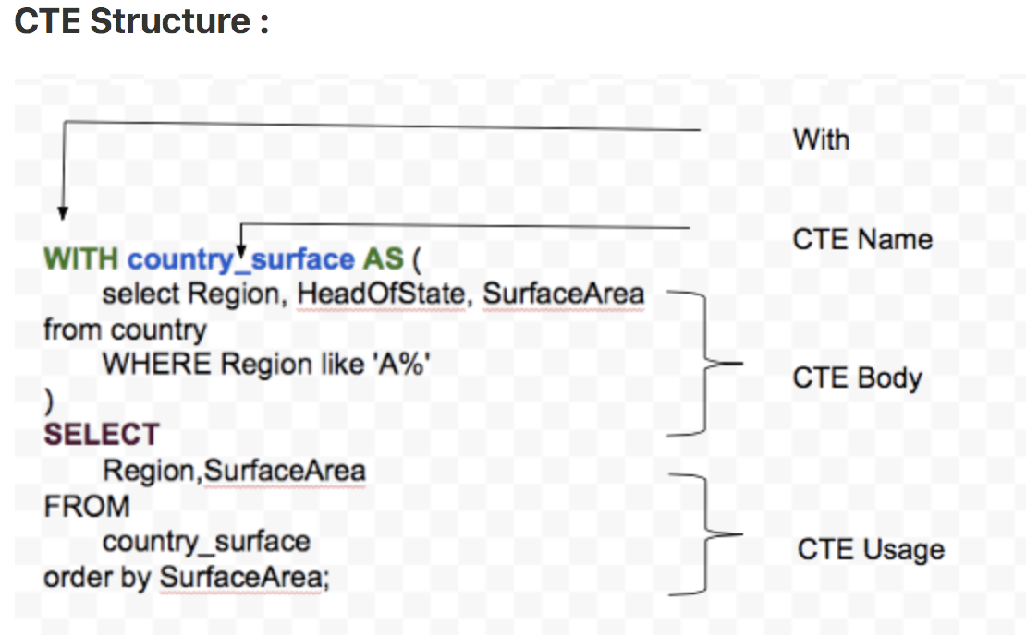
Common Table Expression (CTE)
Simply put, it’s a temporary data set returned by a query, which is then used by another query. It’s temporary because the result is not stored anywhere; it exists only when the query is run.
Syntax
WITH expression_name AS (
CTE definition
)

Slide 16
(CTE) vs Derived table (subquery)
Similar
-CTE is not stored as an object and last only during the execution of a query.
Different
-CTE can be self-referencing (a recursive CTE)
-can be referenced multiple times in the same query.
-provides better readability and performance

Slide 17
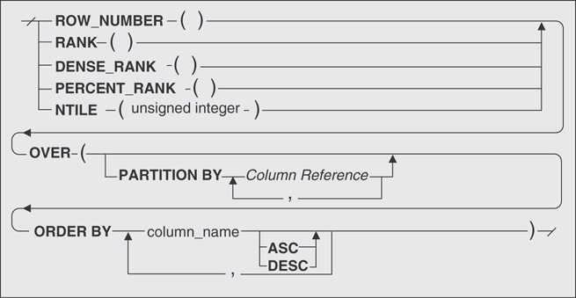
Window Functions
Window functions can group rows into “windows” or “views” that effectively partition the data for use by the analytic function
Syntax:
function (expression) OVER
( [ PARTITION BY expression_list ]
[ ORDER BY order_list ]
[ ROWS frame_clause ])

Slide 18
Window Functions cont’d
Window function predicates:
window partition (PARTITION BY) - groups rows into partitions
window ordering (ORDER BY) - defines the order or sequence of rows within each window
window frame (ROWS) - defines the window by use of an offset from the specified row

Slide 19
Window Functions cont’d
Ranking functions:
ROW_NUMBER
Returns a unique number for each row, with rankings arbitrarily assigned in case of a tie
RANK
Returns the same ranking in case of a tie, with gaps in the rankings
DENSE_RANK
Returns the same ranking in case of a tie, with no gaps in the rankings

Slide 20
Window Functions vs Group By
Window functions don’t reduce the number of rows in the output.
Window functions can retrieve values from other rows, whereas GROUP BY functions cannot.
Window functions can calculate running totals and moving averages, whereas GROUP BY functions cannot.

Slide 21
SELECT statement (DML)
SELECT [ specify columnlist by name or calculated/created columns ]
FROM [ table_list ]
WHERE [ conditional expression ]
GROUP BY [ group by columnlist ]
HAVING [ filter expression on grouped results i.e. WHERE clause on group]
ORDER BY [ columnlist ASC/DESC ]
LIMIT [ # of rows to be returned ]
Notes:
DDL – Data Definition Language DQl – Data Query Language DML – Data Manipulation Language DCL – Data Control Language

Slide 22
Distinct & Distinct On
Limiting number of results not to overload database
SELECT columns… FROM table LIMIT # of records needed
DISTINCT keyword must be applied to remove duplicates in results and/or show unique combinations
DISTINCT ON returns the first row from the set of duplicate rows
Example
SELECT distinct column1
FROM table_name
vs
SELECT distinct column1, column2
FROM table_name
Unique combinations of column1 and column2
SELECT
DISTINCT ON (column1 or expression) column1, columnlist...
FROM table_name

Slide 23
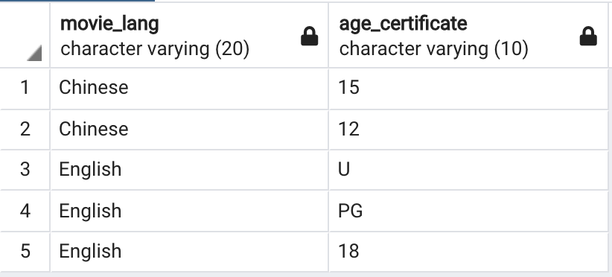
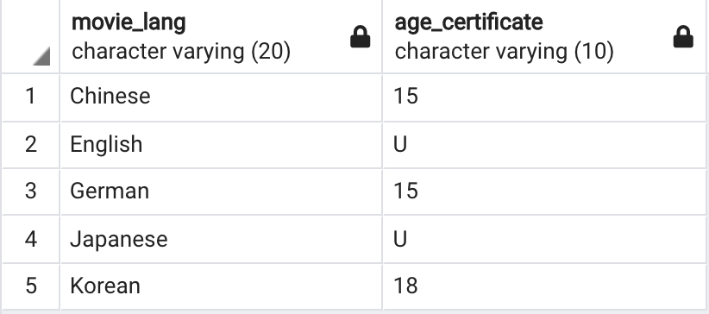
Distinct & Distinct On
Also see here
** See in Class Problems 7-10 **
select distinct movie_lang, age_certificate
from movies
order by movie_lang, age_certificate desc
limit 5;
select distinct on (movie_lang) movie_lang, age_certificate
from movies
order by movie_lang, age_certificate desc
limit 5;

Slide 24
WHERE clause (DML)
Syntax:
SELECT select_list
FROM table_name
WHERE filter_condition
ORDER BY sort_expression
Column conditions that filter/specify which rows should be returned
The conditions in the WHERE clause use operators: comparison, arithmetic, logical operators
Column aliases in the SELECT clause cannot be used in the WHERE clause

Slide 25
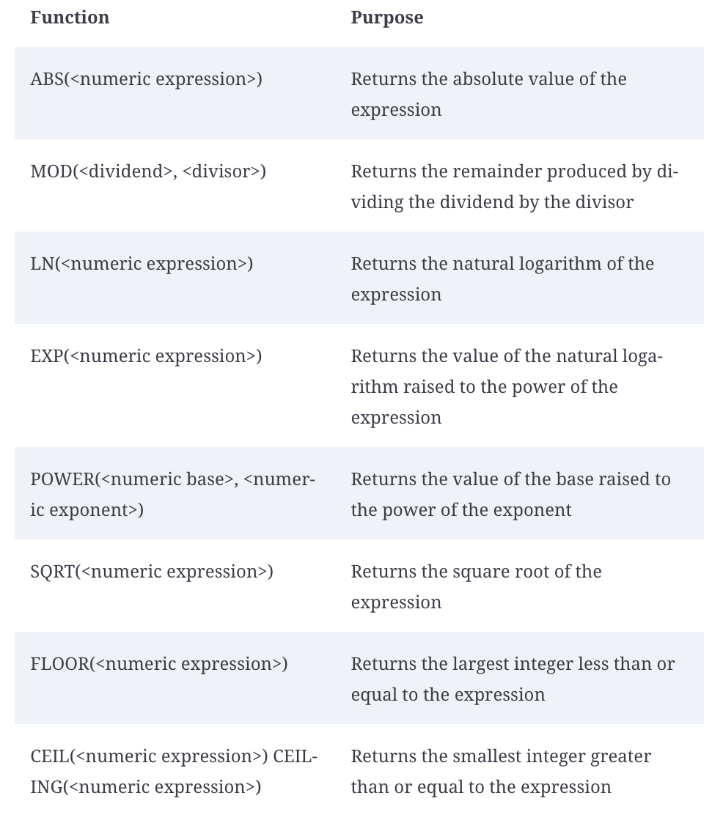
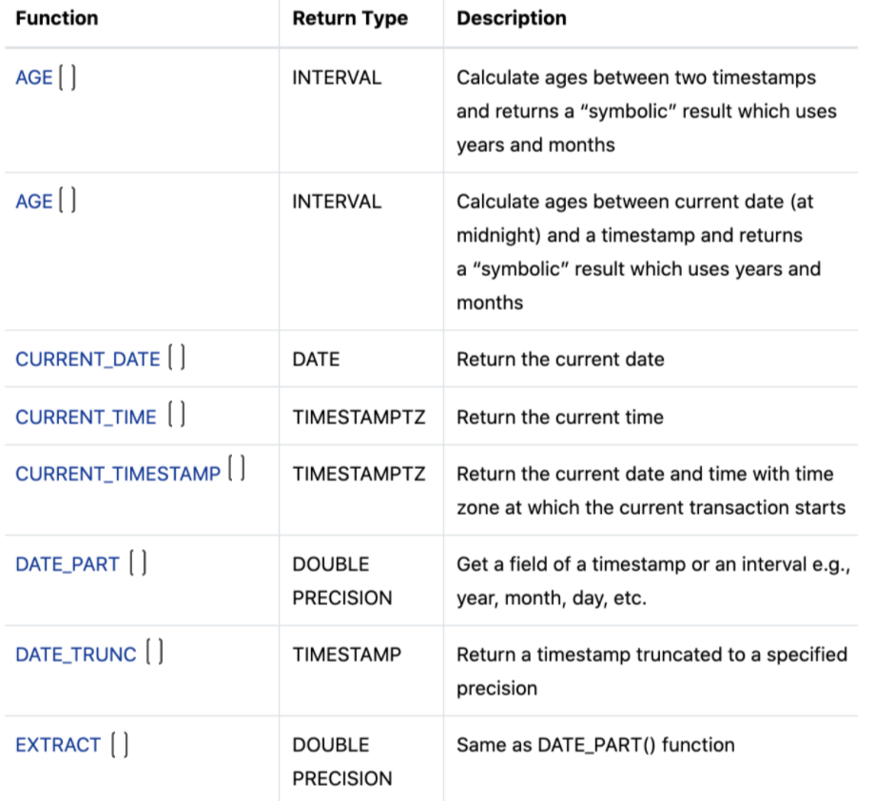
Other Operators & Expressions
Common Math and Date operators
See more Math operators here
See Date operators here

Slide 26
Pattern Matching
LIKE keyword to match a pattern Syntax: WHERE value LIKE ‘pattern’
Percent sign ( %) matches any sequence of zero or more characters
‘%a’ matches any string, regardless of length, that ends with `a`
‘a%’ matches any string, regardless of length, that starts with `a`
Underscore sign ( _) matches any single character.
‘_a_’ matches any three character string where ‘a’ is the second character
Matches are case-sensitive
Example
SELECT
'foo' LIKE 'f%', is true because
'foo' LIKE '_o_', is true
'bar' LIKE 'b_'; is false because bar has 3 letter and the pattern is only 2 letters

Slide 27
Aggregate Functions with Group By
Grouping and summarizing data & other functions here
Most common aggregate expressions for summarizing data: COUNT(), MAX(), MIN(), AVG(), SUM()
Can execute such functions on a table with respect to a filter e.g.
SELECT count(*) FROM table → returns the number of rows in the table
SELECT max(expression) FROM table → returns the maximum value in a set, string or numeric
GROUP BY keyword is used to separate the data returned from a SELECT statement into any number of groups given the column(s) provided to it
Can be accompanied by a HAVING clause → essentially a WHERE statements performed on the group(s) e.g. HAVING count(*) > value
Group By Syntax:
SELECT
column_1,
column_2,
...,
aggregate_function(column_3)
FROM table_name
GROUP BY
column_1,
column_2, …;
HAVING [filter conditions]
These columns become the GROUP BY group selection criteria
Aggregate function such as count() gets computed given the un-aggregated columns
GROUP BY must contain the non-aggregated columns
HAVING clause is the WHERE clause for GROUP BY results

Slide 28
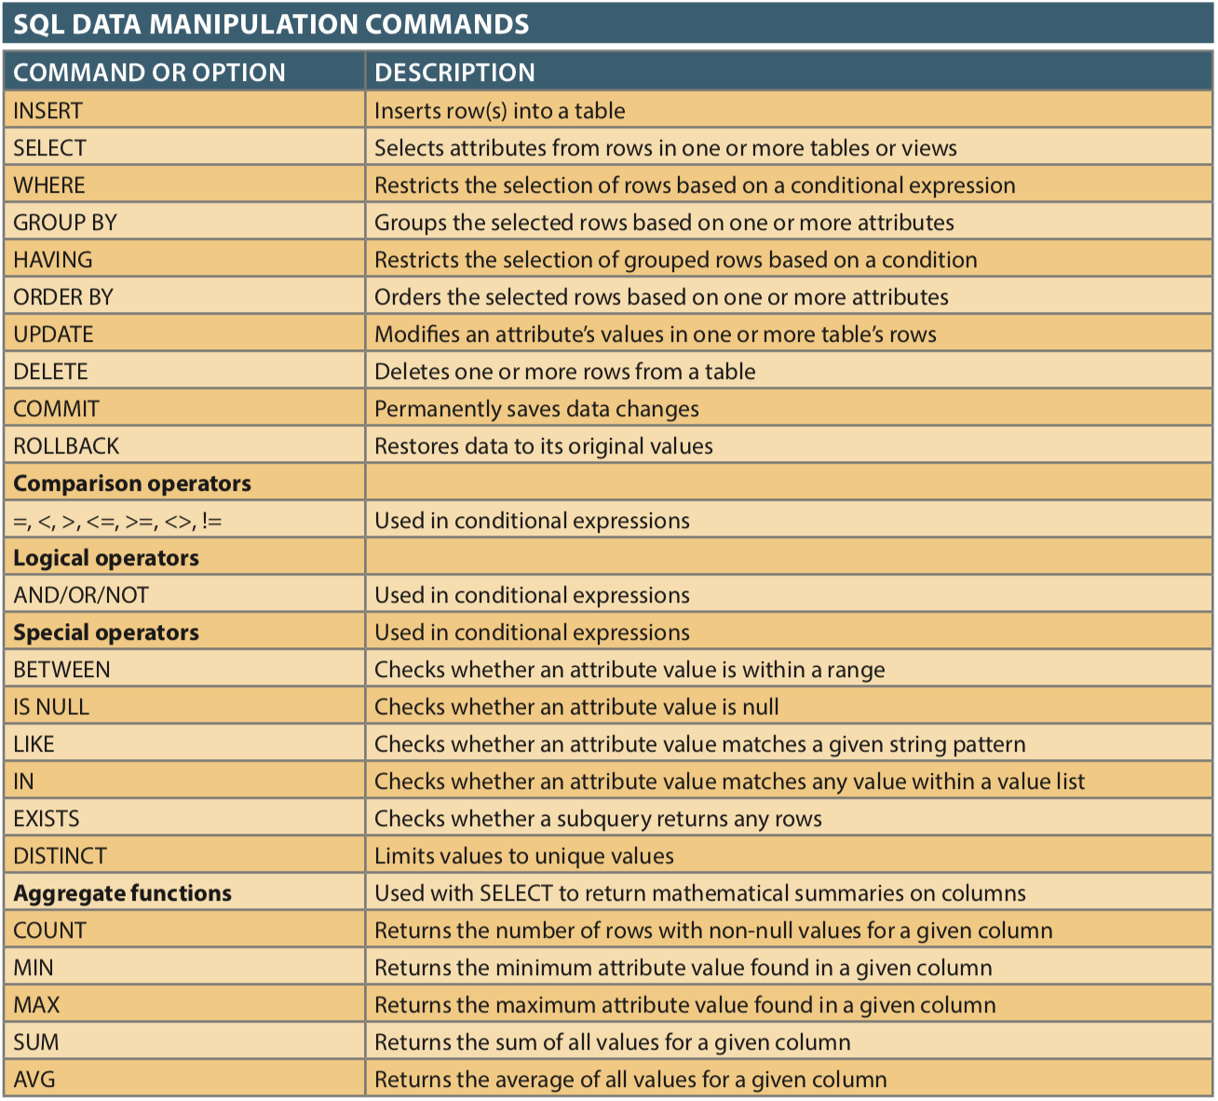
SQL Basics

Slide 29
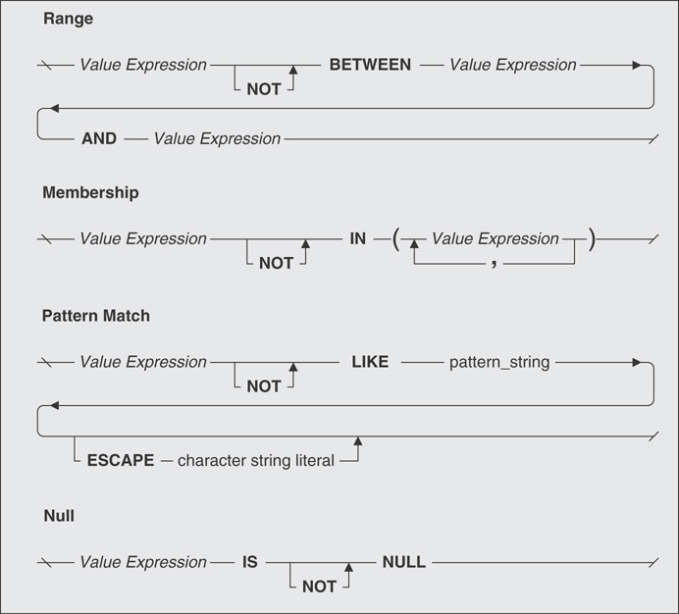
Logical Operator - NOT

Slide 30
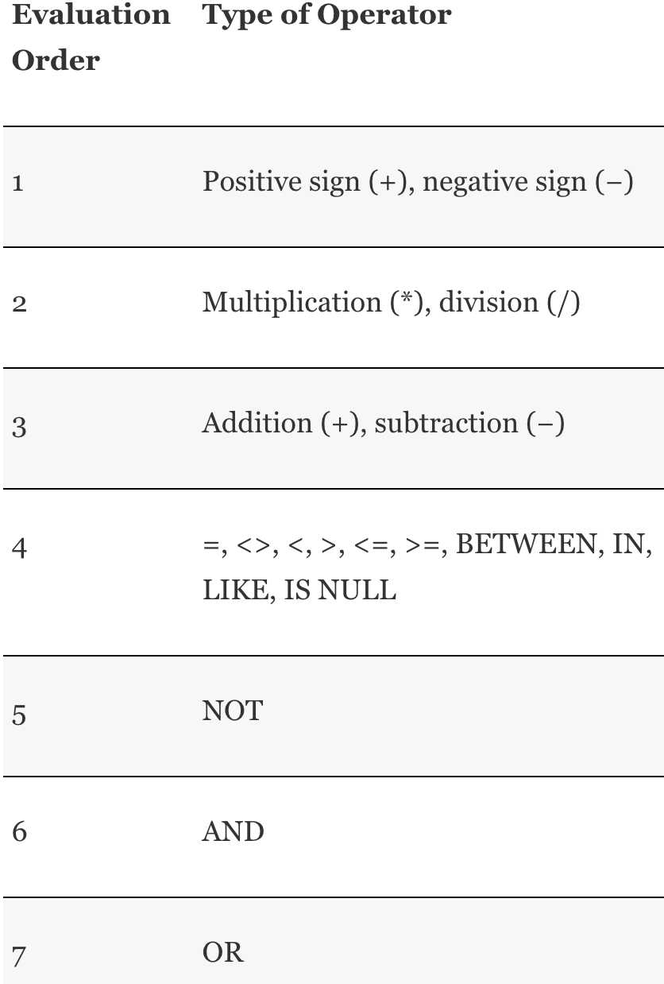
Orders of Precedence

Slide 31
Links/Resources
Postgresql create table
Copy data from file
Data Types & explanations:
Data types documentation, and this and this
Numeric data types here
Tables & data types review (AWS)
PRIMARY KEY constraint
Table & column constraints
Create Table
Alter Table
Psql shell commands

